Slide 1

NFL Wide Receiver Data
Clay Jackson
DS-160
Spring 2024

Slide 2
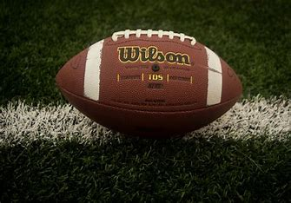
Introduction
Analyzing the stats of NFL wide receivers
Football is the biggest sport in America
Some of the biggest stars In the league are wide receivers
Millions of people now play fantasy football

Slide 3
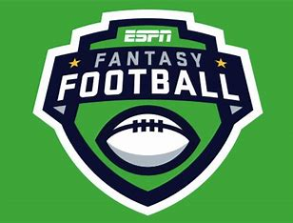
Introduction: Fantasy Football
Before the season, you draft NFL players to be on your team
You earn points for how they perform
A reception = 1 point
10 yards gained = 1 point
A touchdown = 6 points
Touchdowns worth a lot of points. We want to draft players who will score lots of touchdowns!
However, touchdowns very volatile
Can we predict a receiver’s touchdowns based on his underlying stats and metrics?

Slide 4

Project Objectives
Dataset: Advanced Wide Receiver Stats (2021-2023)
Objectives:
Collect and clean dataset
Perform a thorough exploratory analysis
Create an accurate model that predicts the number of touchdowns a wide receiver scores (x = statistics, y = touchdowns scored)
Apply this model to fantasy football drafts

Slide 5

Data Source
Data Source: FantasyPros
Our Dataset: Advanced Wide Receiver Stats
Dataset Structure
28 columns, 590 rows
Every NFL receiver to have caught a pass in the last three years
Statistics and performance metrics
Continuous and discrete

Slide 6
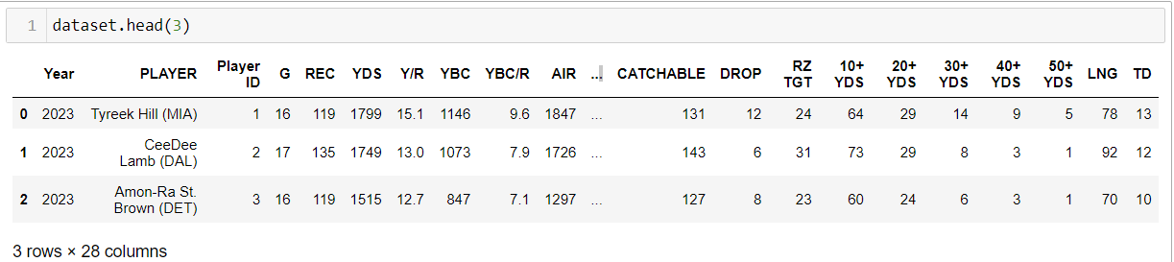
Dataset

Slide 7
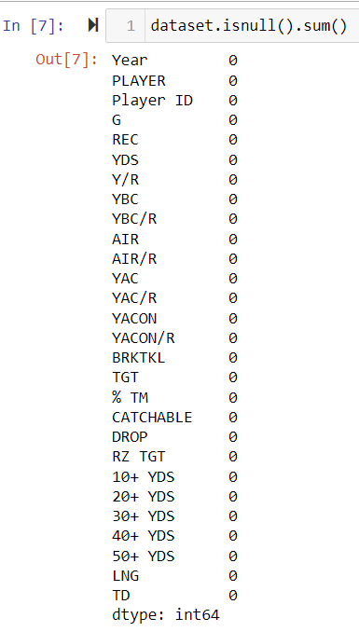
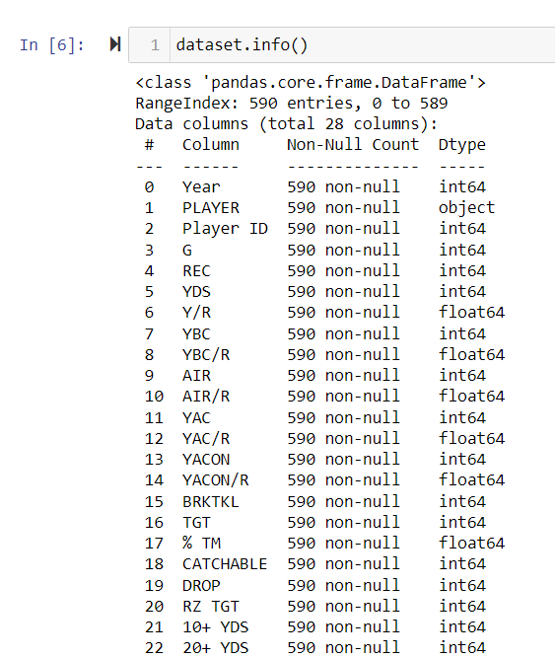
Exploratory Analysis: Data Exploration

Slide 8
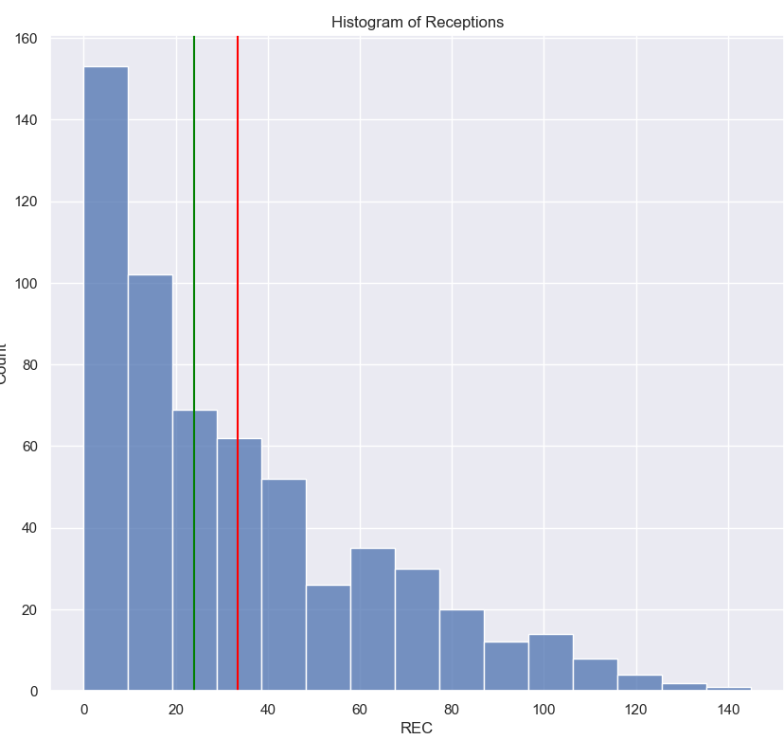
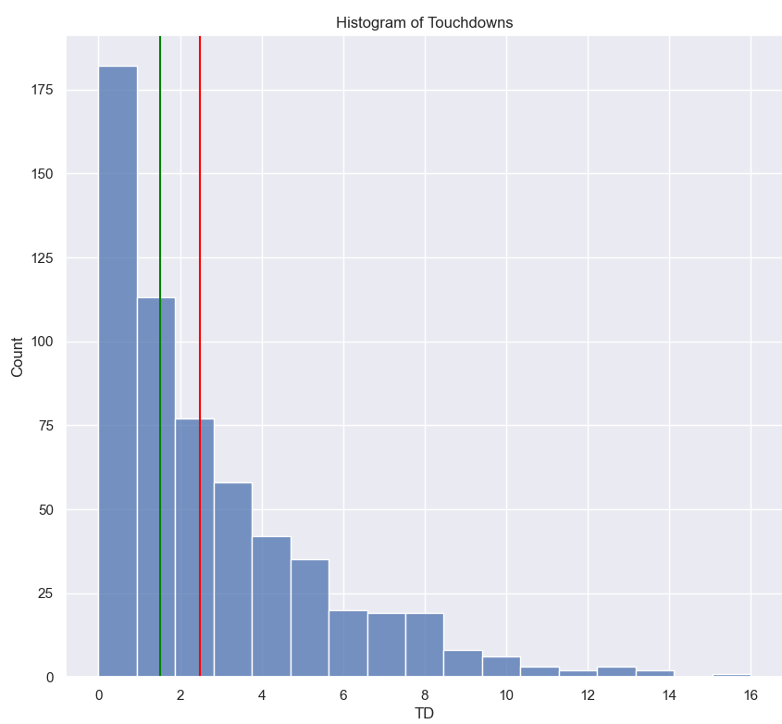
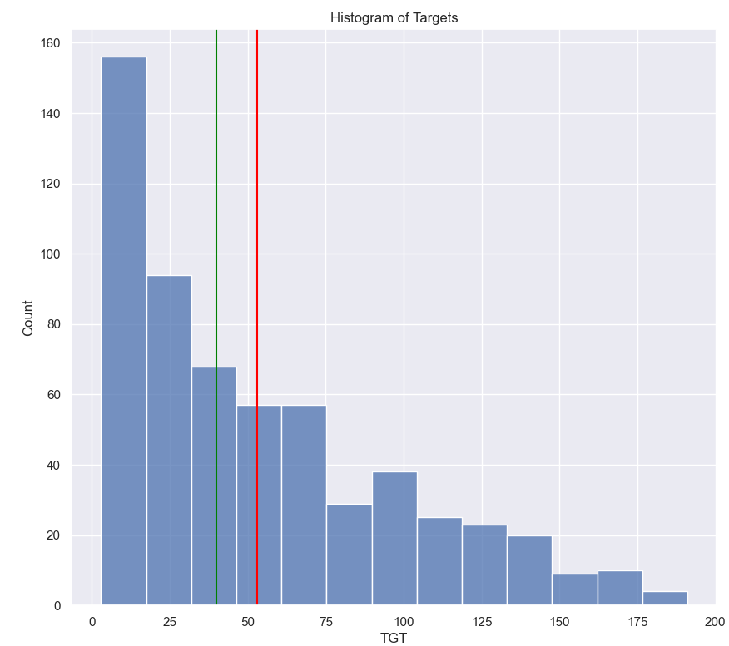
Exploratory Analysis: Distribution
Mean: 33.52 Median: 24
Mean: 2.48 Median: 1
Mean: 53.06 Median: 40
Histogram: Receptions
Histogram: Touchdowns
Histogram: Targets

Slide 9
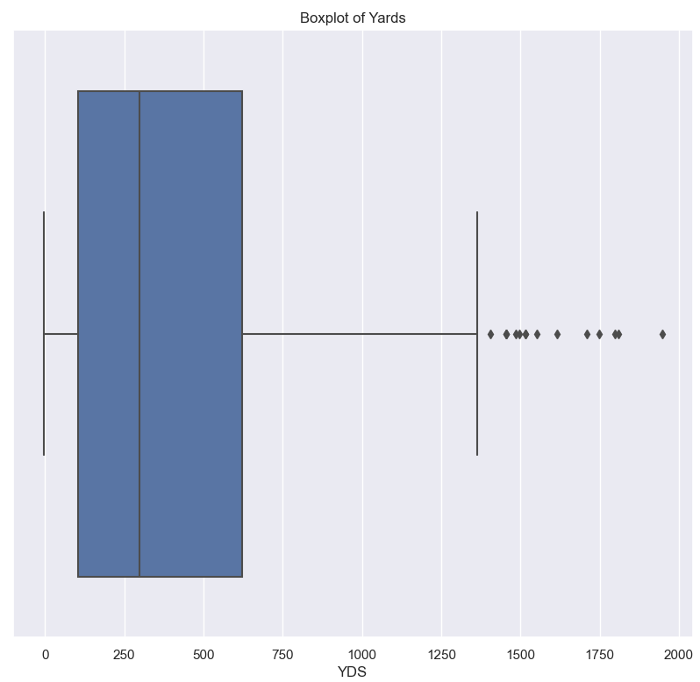
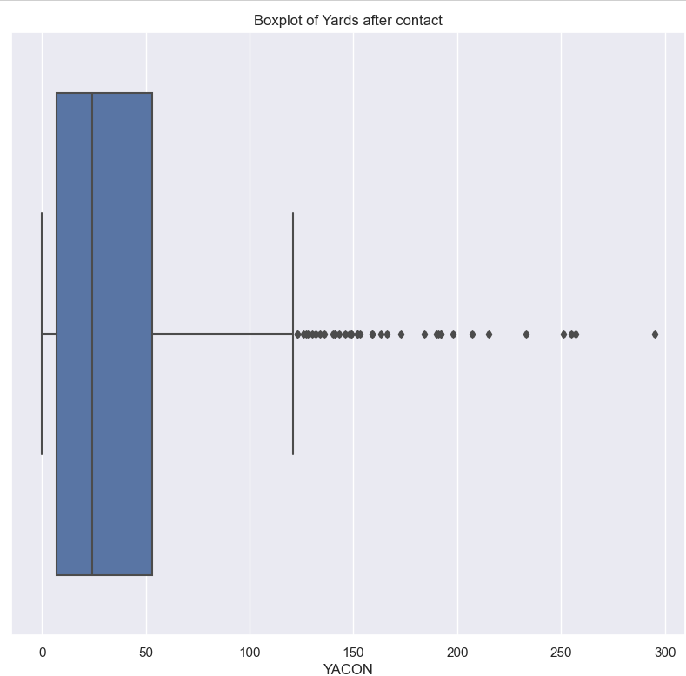
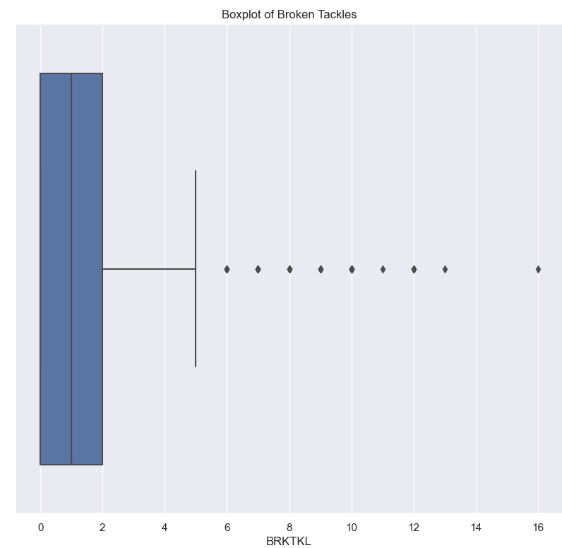
Exploratory Analysis: Distribution
Boxplot: Yards
Boxplot: Yards after contact
Boxplot: Broken Tackles

Slide 10
Exploratory Analysis: Distribution
Takeaways:
Every receiver metric has larger mean than median
Every histogram/boxplot skewed to the right
Positive outliers are skewing the data
Vast majority of NFL receivers put up mediocre statistics
These outliers are the elite, or star, wide receivers in the NFL

Slide 11
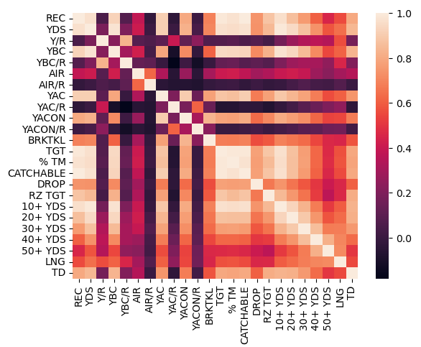
Exploratory Analysis: Correlation
Reminder: Our dependent variable is touchdowns scored

Slide 12
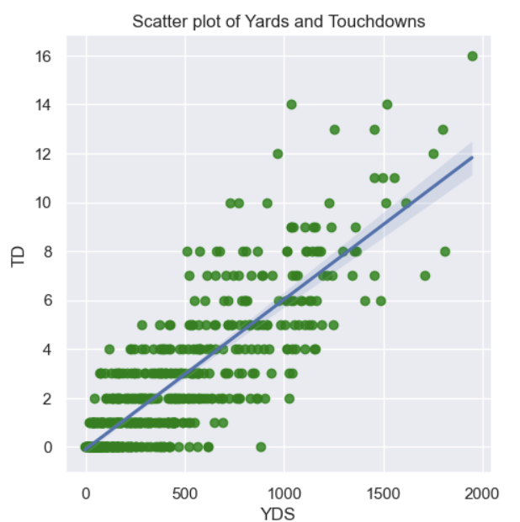
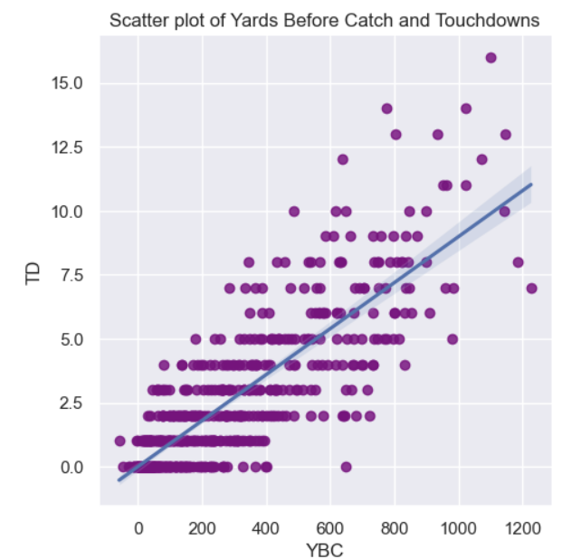
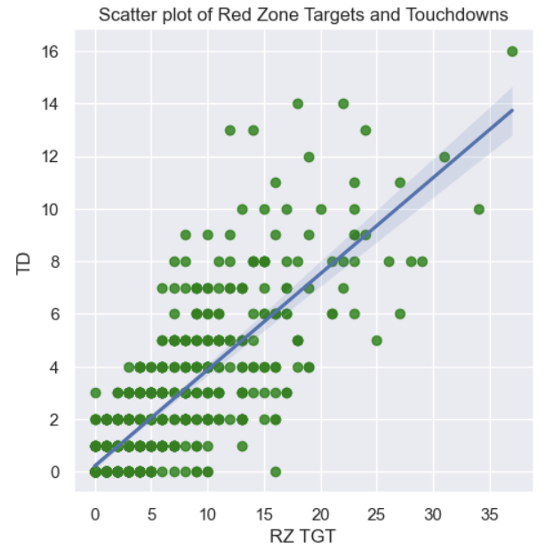
Exploratory Analysis: Correlation
Scatterplot: YDS and TD’s
Scatterplot: YDS and TD’s
Scatterplot: YDS and TD’s
R-squared: .84
R-squared: .83
R-squared: .81

Slide 13
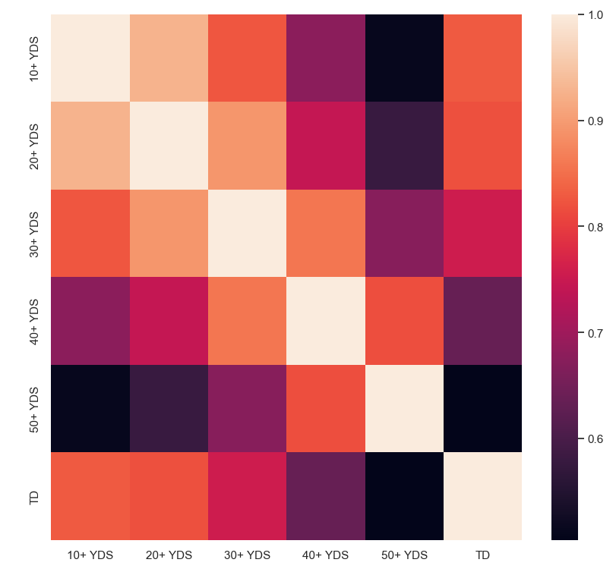
Exploratory Analysis: Correlation
Focused in on the amount of plays a wide receiver had that went for 10, 20, 30, 40 or 50 yards:

Slide 14
Exploratory Analysis: Correlation
Takeaways:
Discovered 15 variables that have moderate to strong correlation with touchdowns score ( > .60)
"per reception" variables have much less correlation to touchdowns scored than overall production (ex. yards has a strong correlation to TD's but yards per reception does not).
The amount of 10 to 30 yard plays a receiver has correlates more to touchdowns than 40 to 50 yard plays

Slide 15
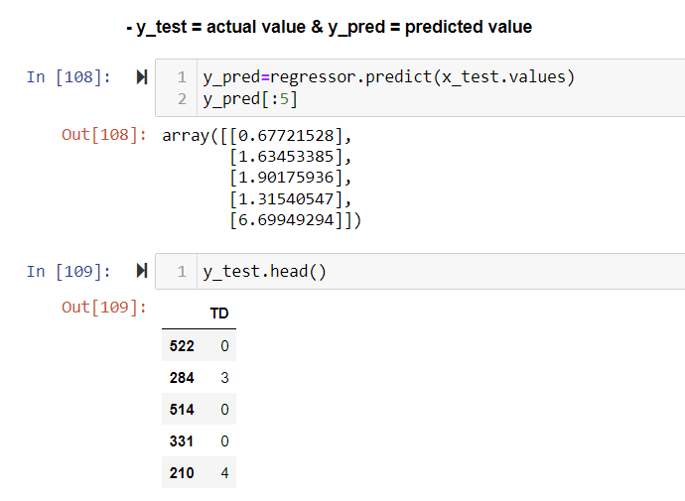
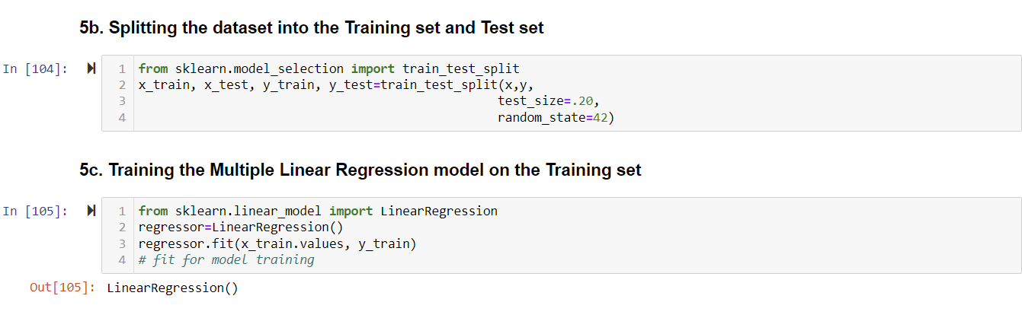
Creating a Model
Multiple Linear Regression Model
Dropped Year, Name, Player ID
Independent variables (x) is the 24 columns of advanced stats
Dependent variable (y) is touchdowns scored

Slide 16
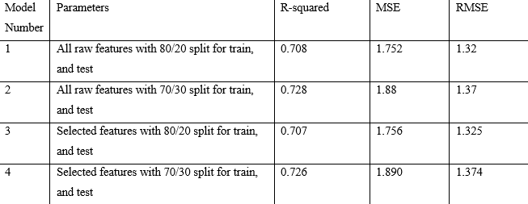
Model Accuracy Results
Raw variables for Model 1 & Model 2: All 24 variables
Selected variables for Model 3 & Model 4: 15 variables with moderate to strong correlation with TD’s scored
Model 2 had the highest R-squared score

Slide 17
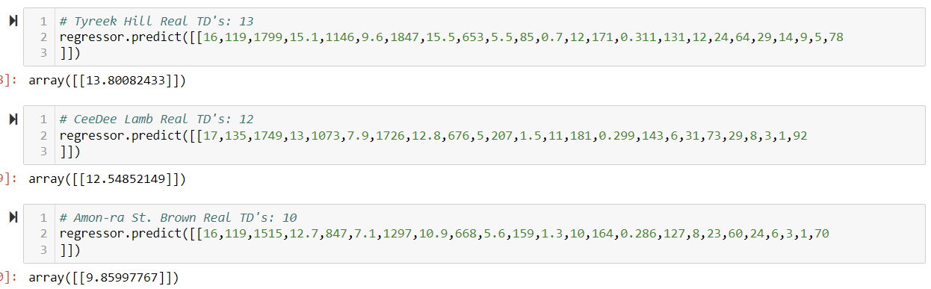
Testing the Model
Tested all four models initially
I then tested Model 2 on 75 receivers’ 2023 season
Compared its prediction to their actual number of TD’s scored
Model 2 was quite accurate

Slide 18
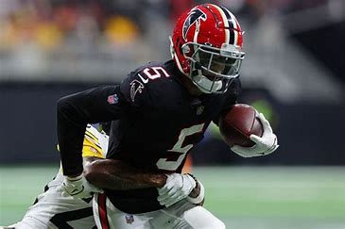
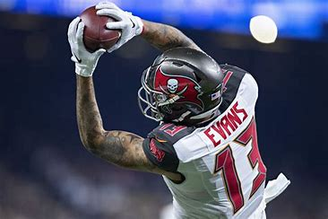
Fantasy Football Application: The Regression Candidates
Drake London
2023 TD’s: 2
Model Prediction: 7.047
Based on his underlying metrics, London should have scored 5 more touchdowns, was unlucky, should regress positively next season
Likely undervalued in drafts, may want to target him in drafts
Mike Evans
2023 TD’s: 13
Model prediction: 8.35
Based on his underlying metrics, Evans should not have scored 13 TD’s, got lucky, should regress next year
Likely overpriced in drafts, may want to avoid.

Slide 19
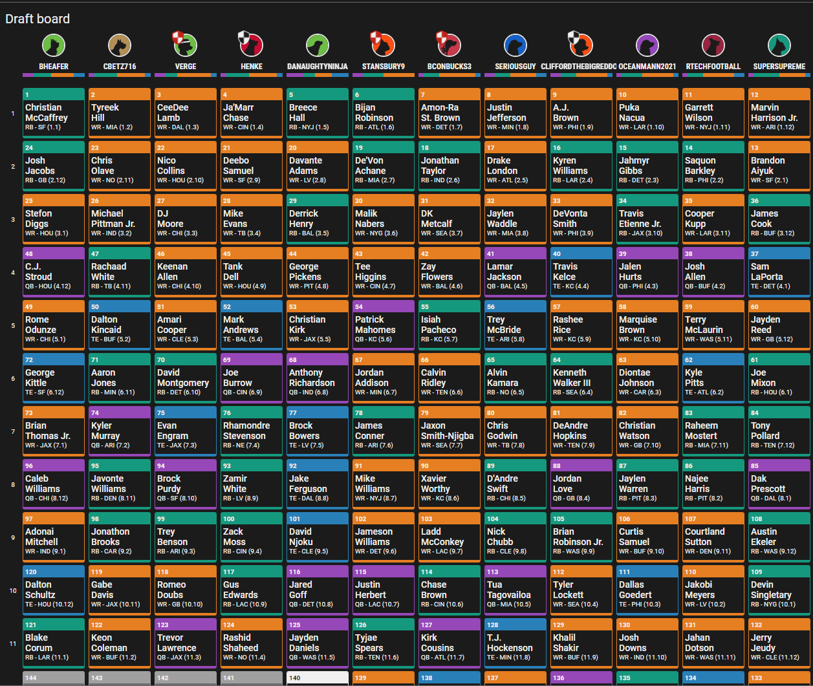
2024 Underdog Fantasy Draft

Slide 20

Reflection & Conclusion
Problems: Time it took to pull data and test model on 2023 receivers
Model Limitations: team success, quality of quarterback, physical traits (height, weight, speed)
Tools: Python, libraries (Pandas, Numpy, Seaborn, SKLearn, LinearRegression), Excel
Conclusion:
Through exploratory analysis, I found distribution patterns and variables that correlate with touchdowns scored
Based on his advanced statistics and metrics, a model can be created to predict a receivers touchdowns scored.
Applied the model to fantasy football drafts: Found regression candidates and used this knowledge to determine our draft targets.

Slide 21
Questions?

